Slide 1
Data Science Bootcamps With Reddit
?

Slide 2
Business Problem
Imagine yourself as a marketer for a data science boot camp.
What might you care about?
How do you know what people are honestly interested in since reviews are public.

Slide 3
Reddit
Site that hosts any topic imaginable
High utility since there are numerous subreddits discussing data science, boot camps, and data science boot camps.
Users are anonymous so opinions shared are more likely to be honest (increase in the validity of comments).
Good site for asking questions and getting answers. StackOverflow for everything else.

Slide 4

The Tools of the Trade
Scrapy
A general framework you can install on python.
Latent Dirichlet Allocation(NLP)
Unsupervised Learning Algorithm
Probabilistic Model
The algorithm discovers patterns in the text based upon variation.

Slide 5
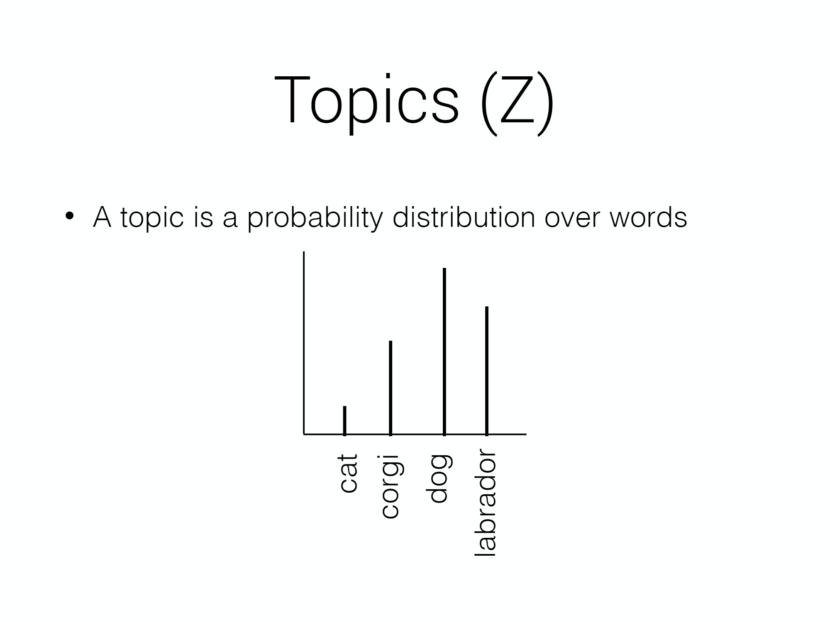
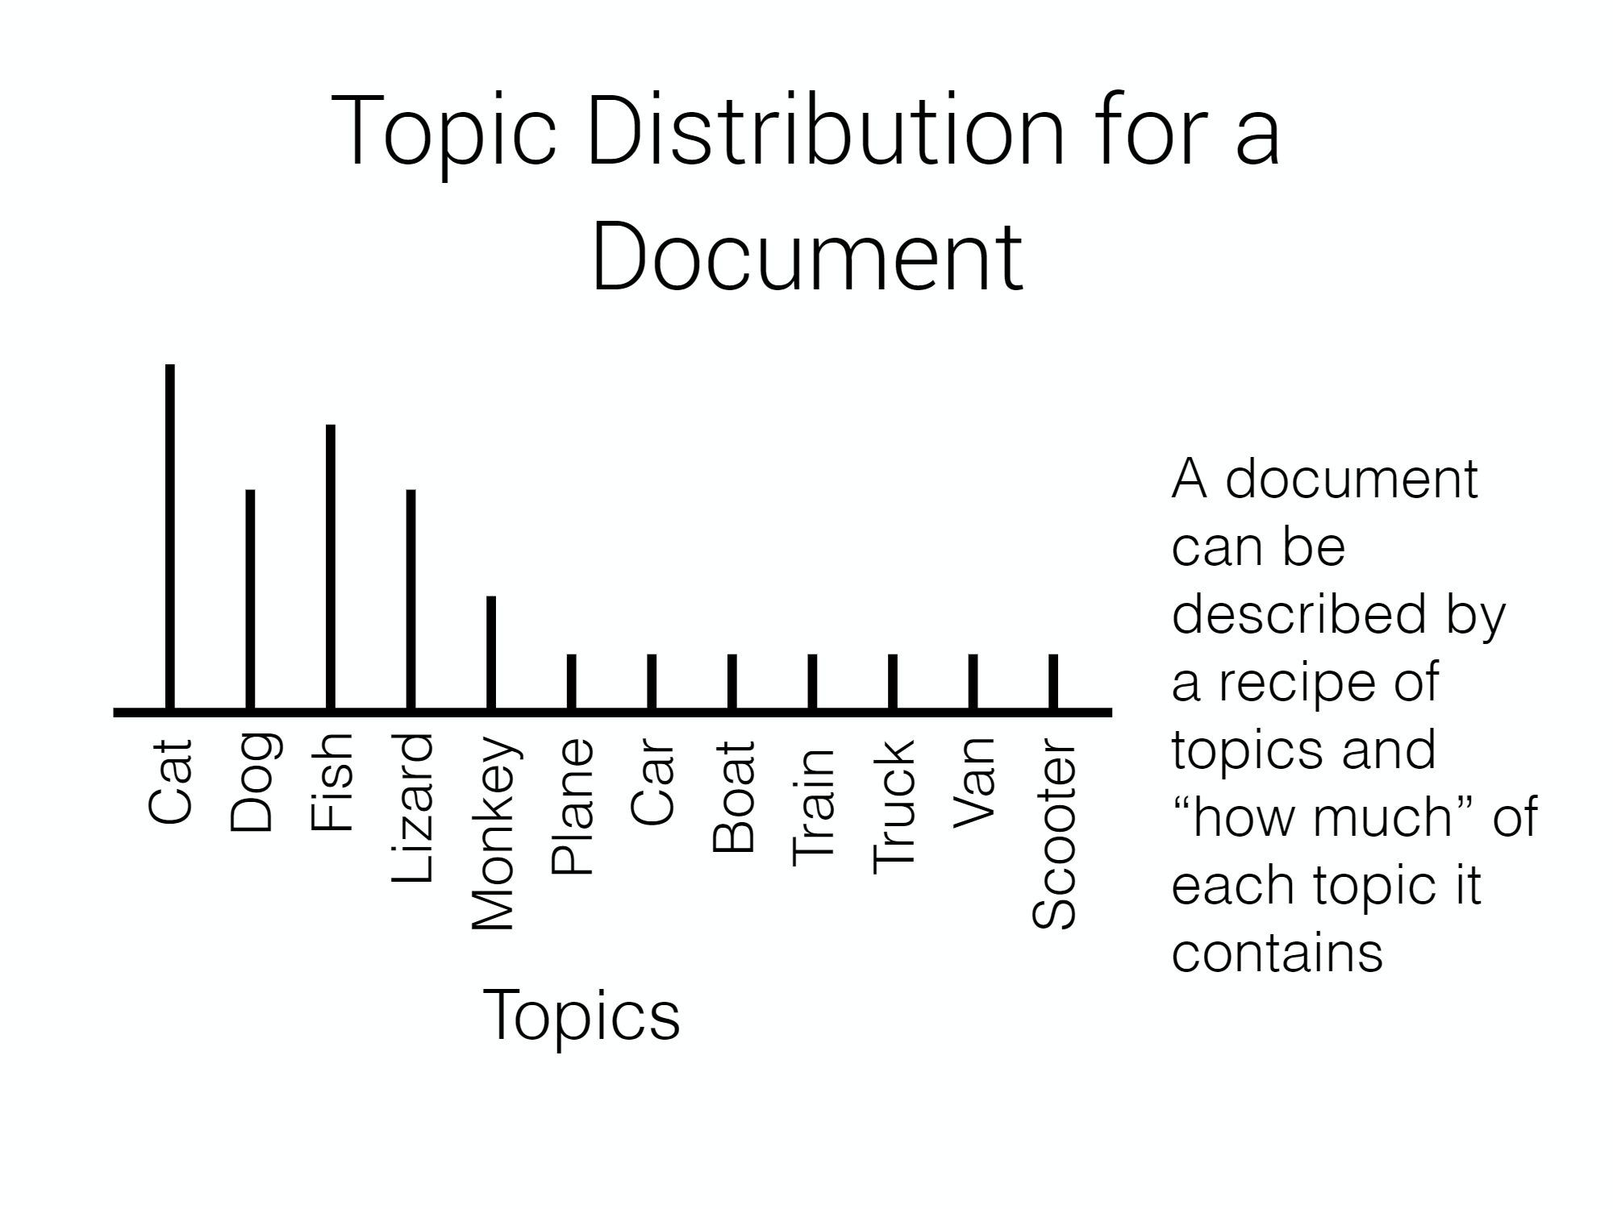
LDA continued

Slide 6
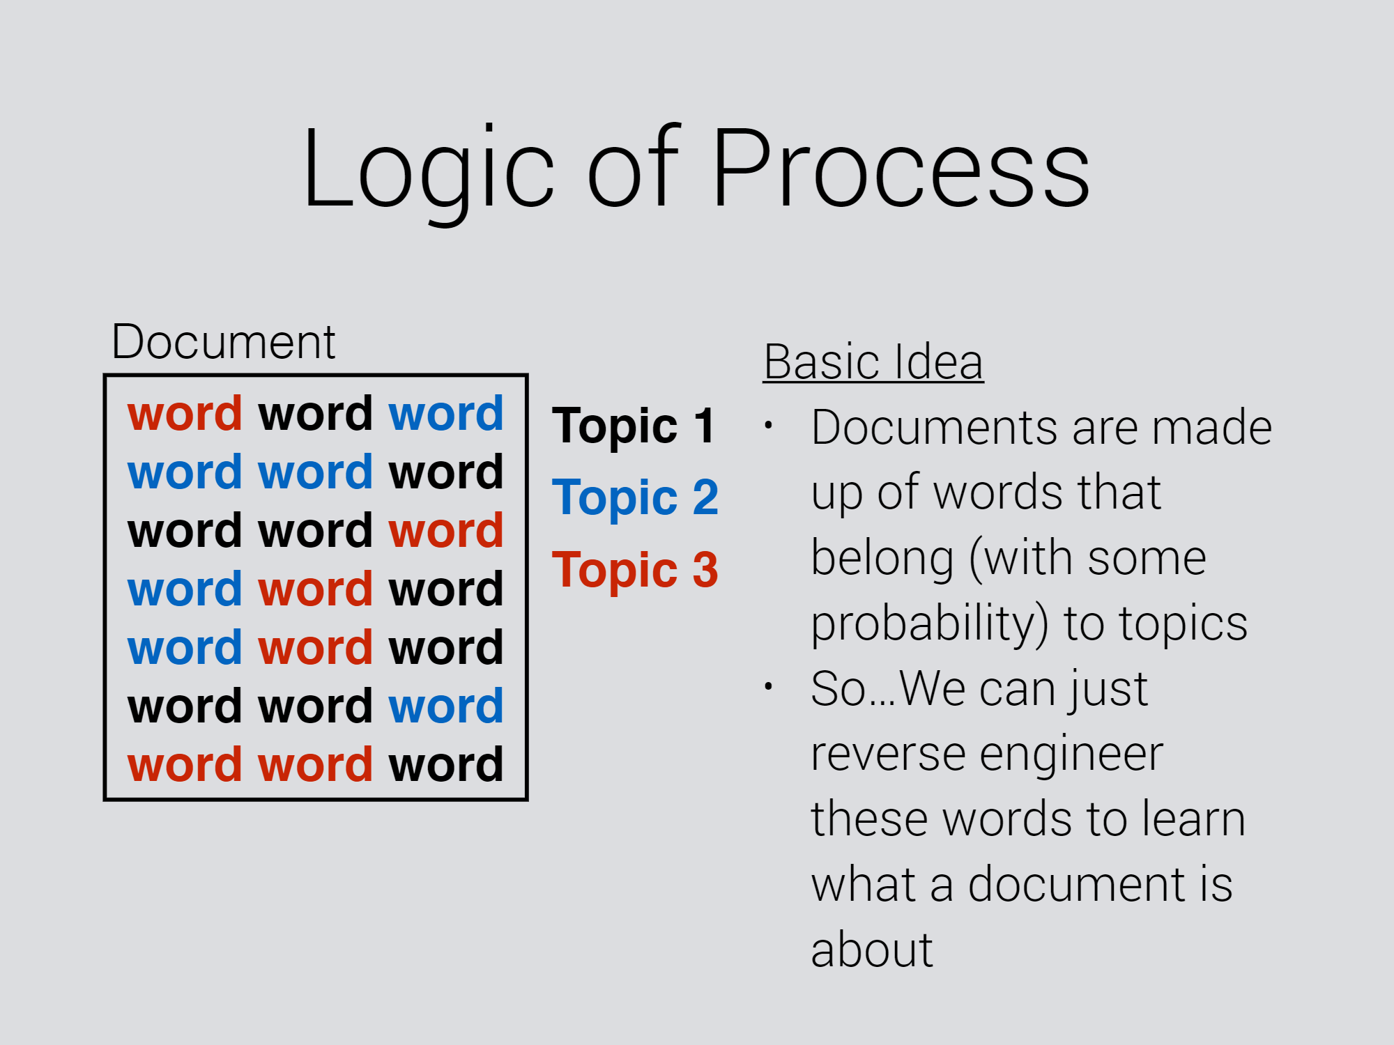
LDA continued

Slide 7
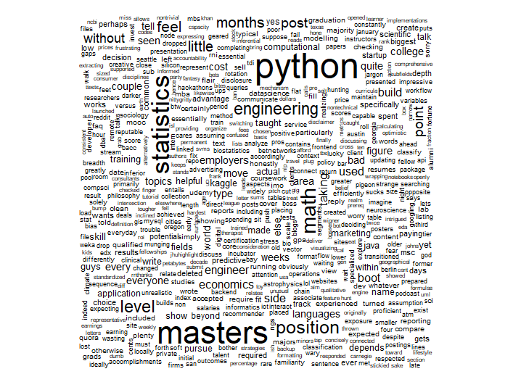
Word Cloud
122,336 words scraped
Total of 5 page lists
[1] "analysis" "analyst" "background" "business" "career" "companies" "company" "courses" "engineering"
[10] "experience" "field" "industry" "job" "jobs" "knowledge" "level" "machine" "masters"
[19] "math" "online" "phd" "position" "programming" "programs" "projects" "python" "research"
[28] "resume" "seems" "sql" "statistics" "stats" "year" "years"

Slide 8
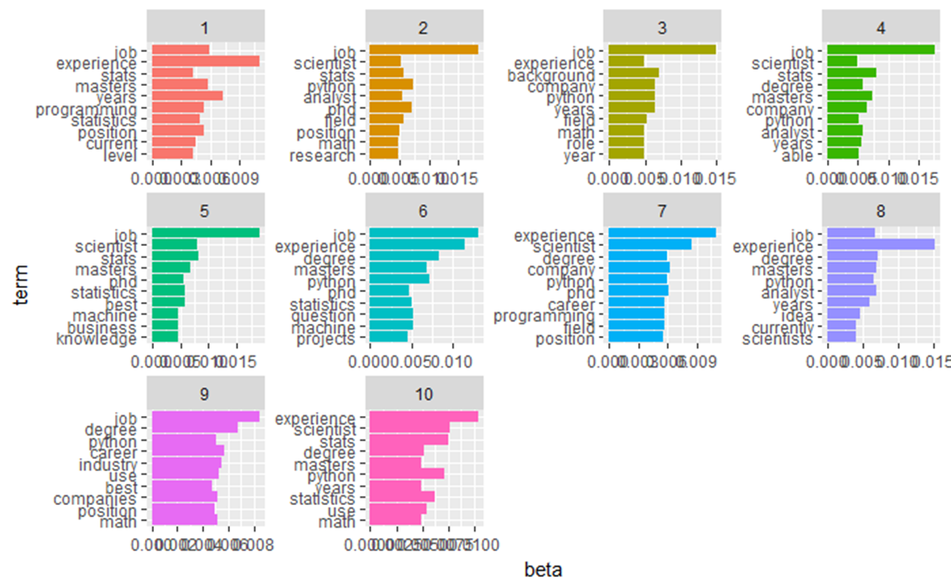
Results

Slide 9
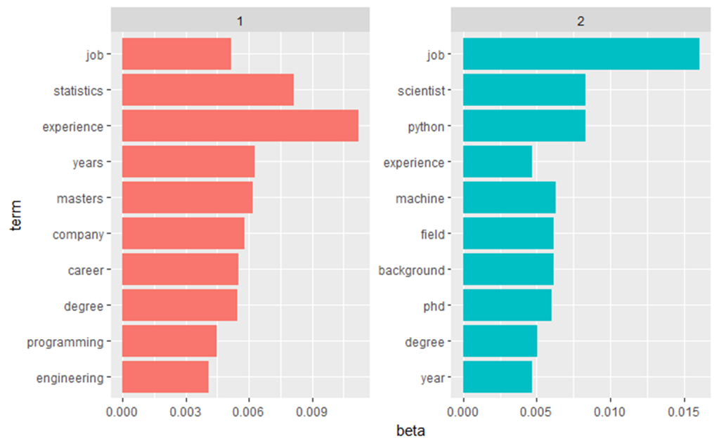
Continued

Slide 10
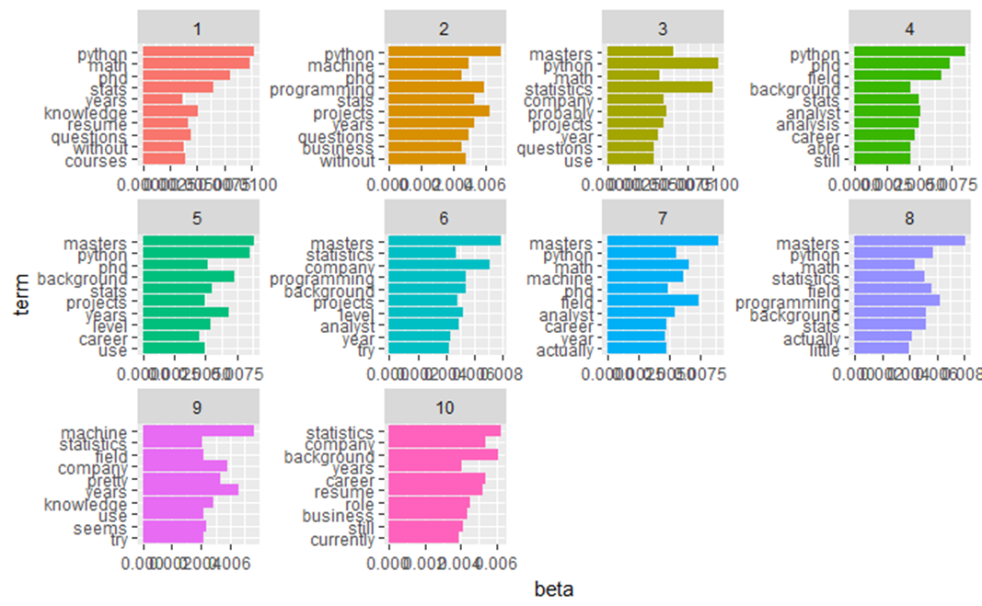
Continued

Slide 11
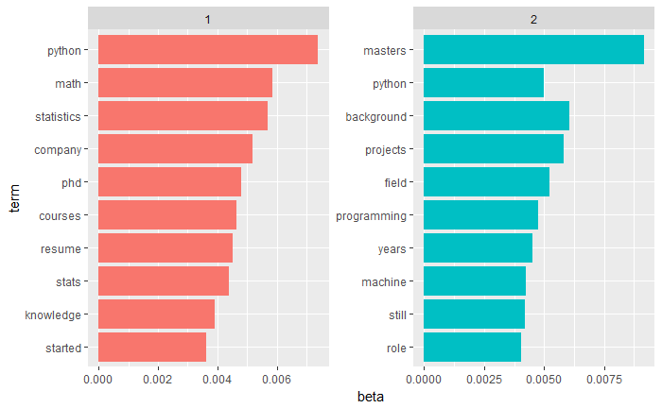
Continued

Slide 12
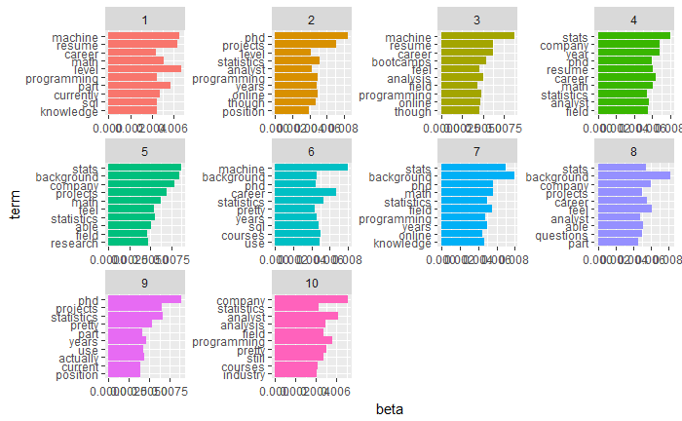
Continued

Slide 13
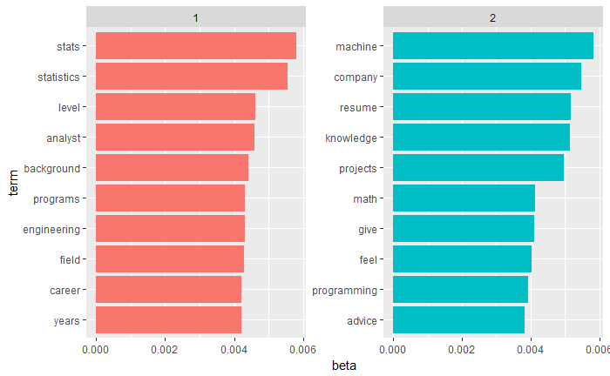
Continued

Slide 14
Conclusion: Surprise!
Major Topics of interest amongst reddit users: Job, Experience
Also python and masters and statistics seem to be other major topics of interest
Limitations: number of words (algorithm clustering the same terms under different topics). Generalizability (sample may not reflect the interests of people interested in data science boot camps)

Slide 15
The future
Scrape reviews based other discussion based sites like Quora
And see how they relate to each other
Increase power of the topic modeling by adding more text.
Compare programming/bootcamps
Focus marketing strategies around related topics of interest
Keep your marketing focused on helping people find a job and host sessions python

